Slide 1
Spawning a bash shell using buffer overflow attacks

Slide 2
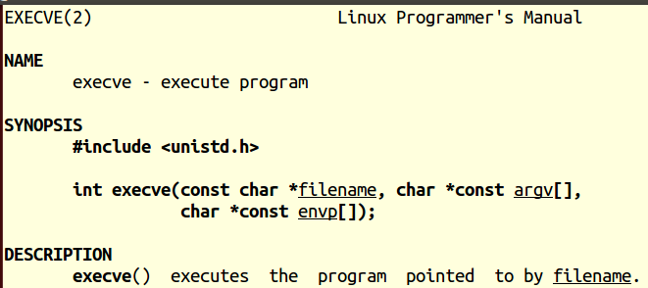
Creating a process using execve
man execve

Slide 3
Spawning a bash shell
int main()
{
char* args[2];
args[0] = “/bin/bash”;
args[1] = NULL;
execve(args[0], args, NULL);
exit(0);
}

Slide 4

Got a bash shell

Slide 5
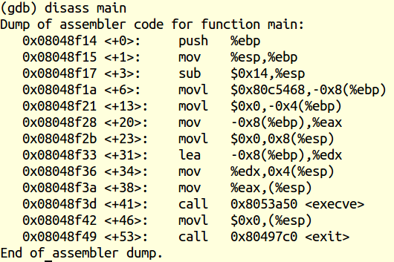
Spawning a bash shell: assembly
Old EBP
High Memory
EBP
-4
-4
-4
-4
Low Memory
ESP

Slide 6
Spawning a bash shell: assembly
Old EBP
High Memory
EBP
NULL (0)
EBP - 4
pointer to /bin/bash
EBP - 8
Low Memory
ESP

Slide 7
Spawning a bash shell: assembly
Old EBP
High Memory
EBP
NULL (0)
EBP - 4
pointer to /bin/bash
EBP - 8
NULL (0)
eax = pointer to /bin/bash
edx = pointer to pointer to /bin/bash
Low Memory
ESP

Slide 8
Spawning a bash shell: assembly
Old EBP
High Memory
EBP
NULL (0)
EBP - 4
pointer to /bin/bash
EBP - 8
NULL (0)
edx
eax
eax = pointer to /bin/bash
edx = pointer to pointer to /bin/bash
Low Memory
ESP

Slide 9
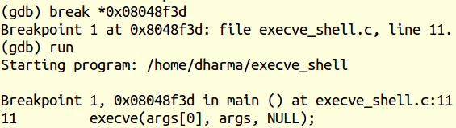

Stack contents: break before execve

Slide 10
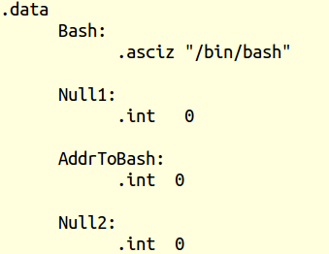
Execve in assembly?

Slide 11
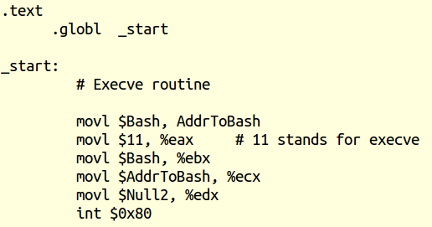
Execve in assembly?

Slide 12
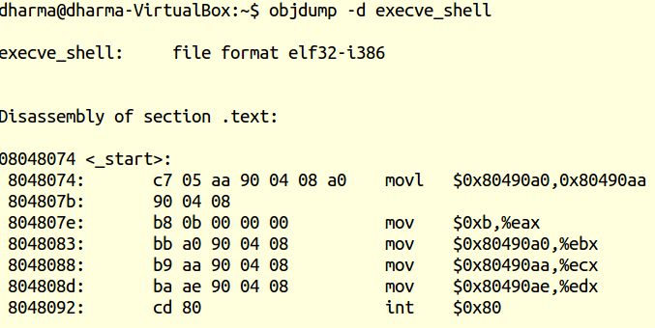
Objdump of the assembly
Problem 1: Null string in the shell code

Slide 13
Objdump of the assembly
Problem 2: Hardcoded address

Slide 14
No Null and Relative Addressing
Null characters in shell code are not good
because they terminate a string
such shell code cannot be executed
Address is hard-coded
Not necessarily transferable between machines
e.g. location of the /bin/bash is hard-coded
Solution: get rid of NULL and hard-coded addressing

Slide 15
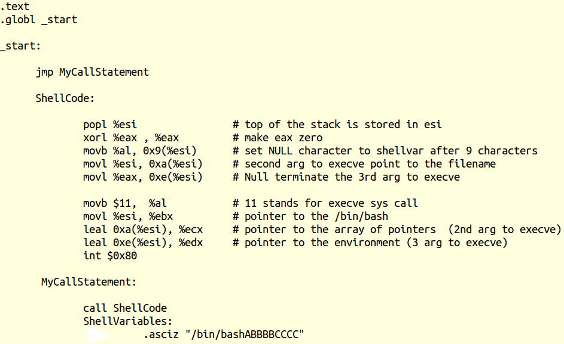
No Null and Relative Addressing

Slide 16
No Null and Relative Addressing …
/
b
i
n
/
b
a
s
h
A
B
B
B
B
C
C
C
C
Contents of Shellvariables

Slide 17
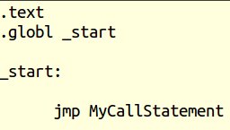
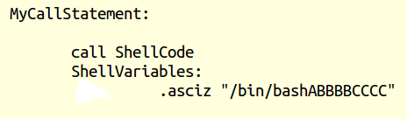
No Null and Relative Addressing
call will push next instruction after return from Shellcode
Top of the stack will point to ShellVariables instruction

Slide 18
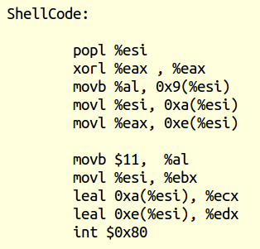
No Null and Relative Addressing

Slide 19
Stack and Register – In ShellCode
Pointer to ShellVariables
High Memory
ESP
Low Memory

Slide 20
Structure of the Stack – Before Call
High Memory
ESP
esi = Pointer to ShellVariables
eax = 0
Low Memory

Slide 21
No Null and Relative Addressing …
Contents of Shellvariables updated at index 9
/
b
i
n
/
b
a
s
h
0
B
B
B
B
C
C
C
C
esi
Since eax = 0: all bytes are zero
Thus, al = 0 (lower 8 bits of eax)

Slide 22
No Null and Relative Addressing …
Contents of Shellvariables updated from index 10 to 13
/
b
i
n
/
b
a
s
h
0
P
Q
R
S
C
C
C
C
esi
Let PQRS be the address pointed by esi

Slide 23
No Null and Relative Addressing …
Contents of Shellvariables updated from index 14 to 17
/
b
i
n
/
b
a
s
h
0
P
Q
R
S
0
0
0
0
esi
Since eax is zero, the last 4 bytes
of ShellVariables will be zero too

Slide 24
Creating a process using execve
man execve

Slide 25
Preparation for execve call
/
b
i
n
/
b
a
s
h
0
P
Q
R
S
0
0
0
0
esi
al = 11; meaning execve call

Slide 26
Preparation for execve call …
/
b
i
n
/
b
a
s
h
0
P
Q
R
S
0
0
0
0
esi
ebx = esi
ebx points to “/bin/bash”

Slide 27
Preparation for execve call …
/
b
i
n
/
b
a
s
h
0
P
Q
R
S
0
0
0
0
esi
ecx = address of address
ecx points to the address starting from 10th index of ShellVariables

Slide 28
Preparation for execve call …
/
b
i
n
/
b
a
s
h
0
P
Q
R
S
0
0
0
0
esi
edx = null
edx points to the address starting from 14th index of ShellVariables

Slide 29
Preparation for execve call …
edx
/
b
i
n
/
b
a
s
h
0
P
Q
R
S
0
0
0
0
ebx
ecx
ebx register points to the “/bin/bash” string
ecx register points to the array of pointers with null termination
edx register points to the environment array of pointers which is null in our case

Slide 30
Preparation for execve call …
envp
/
b
i
n
/
b
a
s
h
0
P
Q
R
S
0
0
0
0
ebx
args[0]
args[1]
execve(“/bin/bash”, args, envp);
args[0] points to the address where “/bin/bash” is stored
args[1] is our null string
envp is our null string

Slide 31
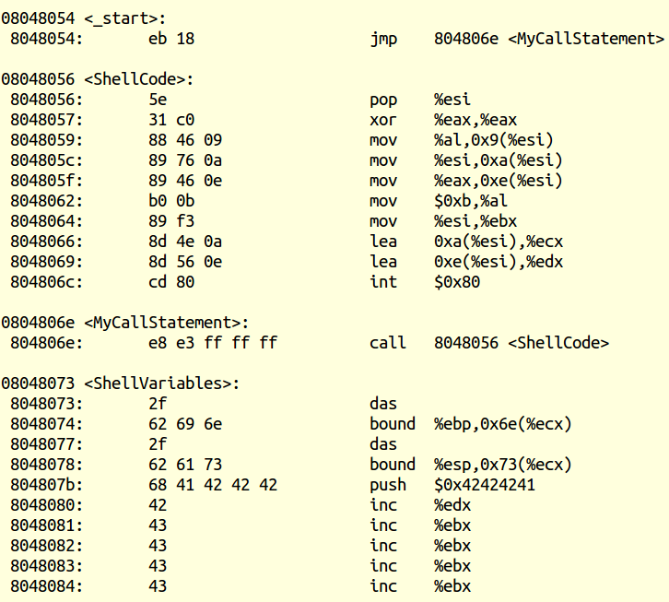
Shellcode from objdump
No NULL string in our shell code
Ready for injection

Slide 32
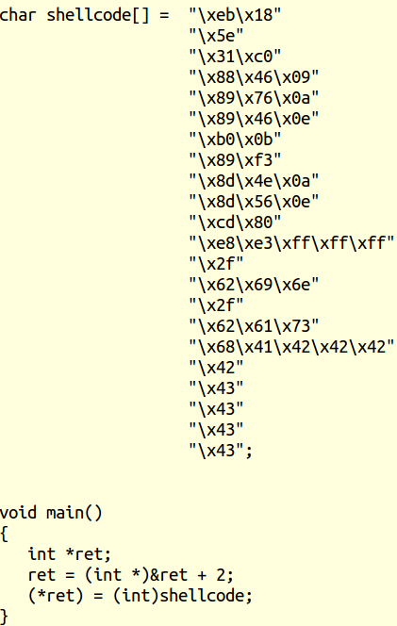
Copy and paste of shellcode into a character buffer
Override return to libc
(see the last lecture)

Slide 33
Stack Layout – Inside Main
High Memory
*ret = shellcode
Ret address of main is overridden
EBP+4
shellcode
EBP
EBP – Old
(libc main)
ret =
EBP + 4
ESP
Low Memory

Slide 34

Shellcode injected successfully!
Got a bash shell using stack overflow !

Slide 35
Summary
Shellcode should not contain NULL
Hard-coded addressing is also not good for wide-spread attacks
Shellcode can be programmed to use relative addressing

Slide 36
Summary …
Try these types of analysis at home
Make sure the following for gcc:
-mpreferred-stack-boundary=2
-zexecstack
-fno-stack-protector

Slide 37
References
Computer Systems programmer’s perspective
Chapter 3 on Procedures
Secure Coding in C and C++
Chapter 3 on Pointer Subterfuge
Hacking – The art of exploitation
Chapter 3 on Buffer Overflows
Chapter 5 on Shellcode
http://www.shell-storm.org/shellcode/
Archive of shellcode
Security Tube – Acknowledgement: Mr. Vivek Ramachandran

